Slide 1

IoT Sensor Blinding
Alex Winstead (awinstead2015@my.fit.edu)
Xuchao (Steven) Jiang (xjiang2017@my.fit.edu)
Cole Clements (cclements2016@my.fit.edu)
Jeremy Gluck (jgluck2016@my.fit.edu)
Todd St. Onge (tstonge2016@my.fit.edu)
Matthew Craven (mcraven2015@my.fit.edu)

Slide 2
Basics
Faculty sponsor: Dr. O’connor (toconnor@fit.edu)
Client: Dr. O’Connor (toconnor@fit.edu)
Meeting(s) with the Client:: Thursday at 12:30 every week

Slide 3
Goal
To further on Dr. O’Connor’s research in sensor blinding by creating machine learning code to help select which packets to block and which to let through in addition to this we hope to expand on the Blinding techniques developed by Dr. O’Connor, as well as exploit new attack vectors. This will help expose vulnerabilities in IoT devices in use today. In doing so we will inform manufacturers of security flaws in products.

Slide 4
Approach
Further Dr.O’Connor’s research by building a lab to perform testing and research on IoT devices.
Use machine learning in conjunction with data collected from Groove API we will build a model to detect, and predict packets from the IOT, specifically targeting packets that contain on-demand traffic. These packets are more variable. This task will be broken down into the below sub parts.
Use Groove API create a test site that allows us to receive and send packets within devices while tracking the data sent and received.
Use Groove API we will collect data and package it into a usable form. This point will require mathematical analysis to determine the best models to use whilst training our machine learning model in the next step.
The last part will be training and testing our Machine learning model.
Use a wireless network connection to Jam a device.
Complete a paper on our findings with Dr.O’Connor.

Slide 5
Features and Challenges
Novel features/functionalities:
Ability to block on-demand traffic without affecting always responsive traffic.
Ability to Jam a target device wirelessly.
Ability to determine packet types based on features gathered from encrypted 802.11 frames and other wireless signals (to be determined).
Technical Challenges:
The teams understanding of x86 assembly is limited and this will be needed to understand embedded code on IoT devices.
When we jam the on-demand traffic we need to make sure we do not jam the always responsive packets.
The groups Networking knowledge is not as advanced as it should be to be able to look at a wide scope of possible uses for sensor blinding. By increasing this knowledge it will allow us to find better exploits and opportunities for expansion of the project features. We will study various wireless communication protocols for the purpose of identification

Slide 6
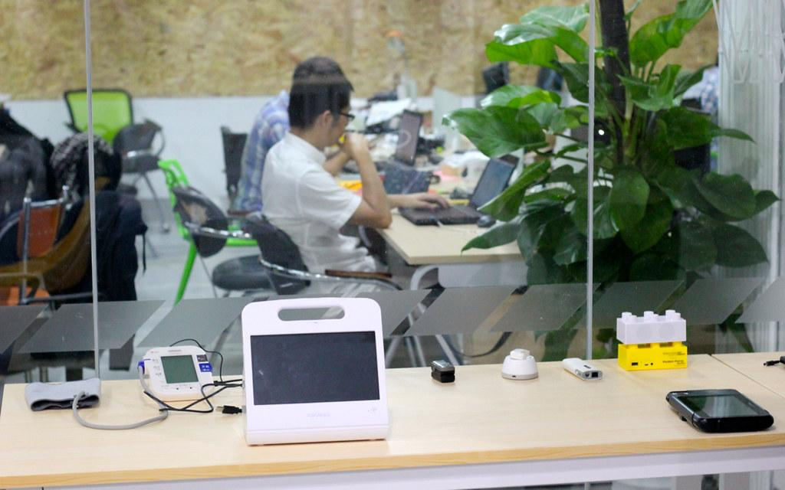

Milestones 1
Due Date: Sep 30
Itemized tasks:
Build laboratory
Familiarize ourselves with Dr. O’Connor’s research
Recreate previous research results in lab setting
Create Requirement Document
Create Design Document
Create Test Plan

Slide 7

Milestones 2
Due Date: Oct 28
Itemized tasks:
Capturing wireless traffic from IoT devices in lab (i.e. building knowledge base for detection models)

Slide 8

Milestones 3
Due Date: Nov 25
Itemized tasks:
Label database
Identify model features

Slide 9
Work Matrix
 | Alex | Cole | Jeremy | Steven | Todd
select technical tools | collaborate | collaborate | collaborate | collaborate | collaborate
build laboratory | research | research | research | research | research
resolve technical challenges | build database model | look at old pcaps | learn aircrack-ng | learn 802.11 | analyze Z-wave protocol
capture network traffic in lab | monitor | monitor | monitor | monitor | monitor
design plan | write 20% | write 20% | write 20% | write 20% | write 20%
requirement document | write 20% | write 20% | write 20% | write 20% | write 20%
test plan | write 20% | write 20% | write 20% | write 20% | write 20%

Slide 10
Questions??

